Slide 1

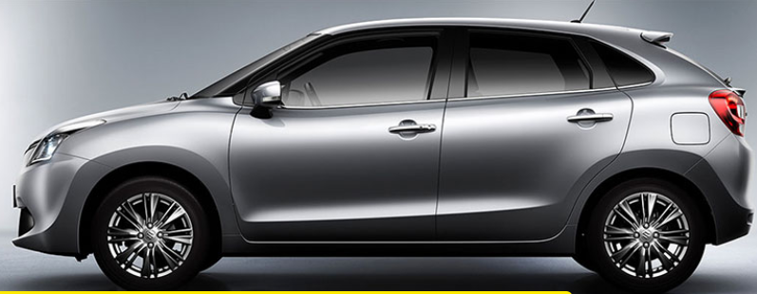
By-TEAM PANDAS
Priyanka Pagare
Garima Rawat
Naureen Khan
Rahul Kirpane
Fakhruddin

Slide 2
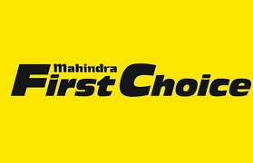
Multi Brand Car Service Center
Mahindra First Choice Services is India’s leading chain of multi-brand car service workshops offering wide array of services. We focus on enhancing your driving experience by offering world-class car maintenance services for cars of all makes and models. Our sole mission is “To provide car care services to keep the cars fit and healthy and customers happy and smiling”.
With well-equipped car service stations and fully trained mechanics, we provide quality services with excellent packages that are designed to offer you great savings.
Our state-of-art workshops are conveniently located in many cities across the country. Now you can book your service online at the nearest Mahindra First Choice Services Workshop.

Slide 3
Problem Statement
Geolocation Based Analysis:
Generating meaningful insights on Geolocation Based Customer & Revenue Analysis.
Identify the type of order each state receives and present it as an interactive visualization
Market segmentation :
Lifetime value analysis of customers to maintain relationship with high profit generating customers in future & finding potential customers from the population.
Divide the customer base into segments based on their car type,service type and total spend such that these customers will respond similarly to the different marketing campaigns.

Slide 4
Data In Hand
Customer csv: 5,55,338 rows and 9 columns.
Invoice csv: 492314 rows and 59 columns.
Jtd csv: 5619484 rows and 10 columns.
Plant Master csv: 438 rows and 13 columns.

Slide 5
Geolocation Based Analysis
Ownership Pattern
Spending Pattern

Slide 6
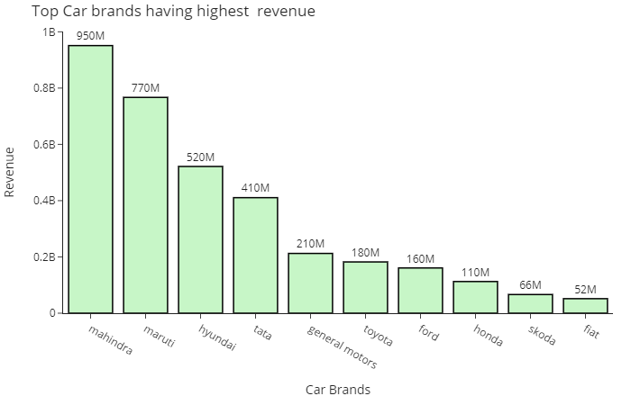
Analysis Of Make And Models
(Revenue)
Mahindra has highest revenue
Other car brands also provides revenue to the company and with good contribution
To View DashBoard

Slide 7
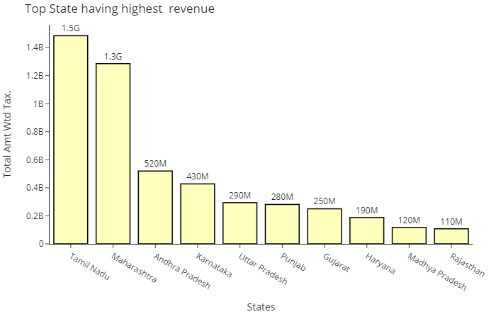
Revenue Generation Across States
Tamil Nadu provides highest revenue
Accidental orders in Tamil Nadu leads to highest revenue
To View Dashboard

Slide 8
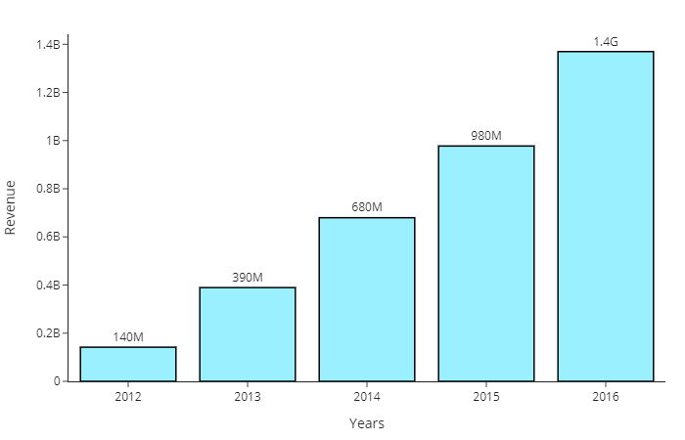
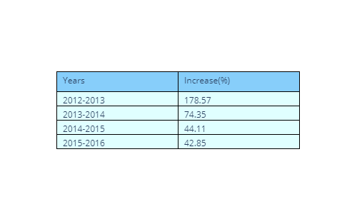
Revenue Generated Over The Years

Slide 9
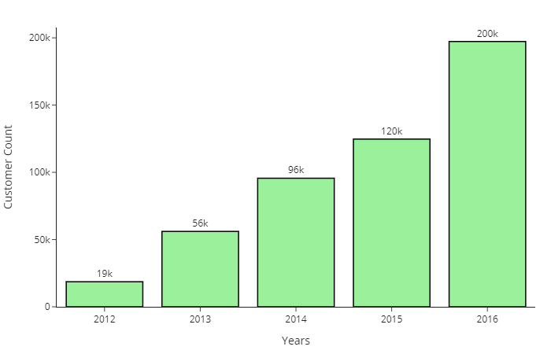
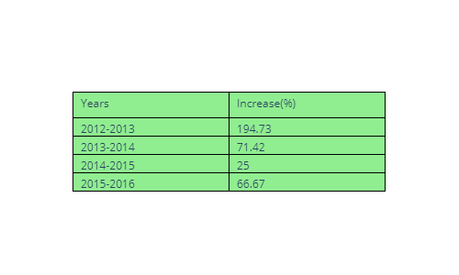
Customer Count Over The Years

Slide 10
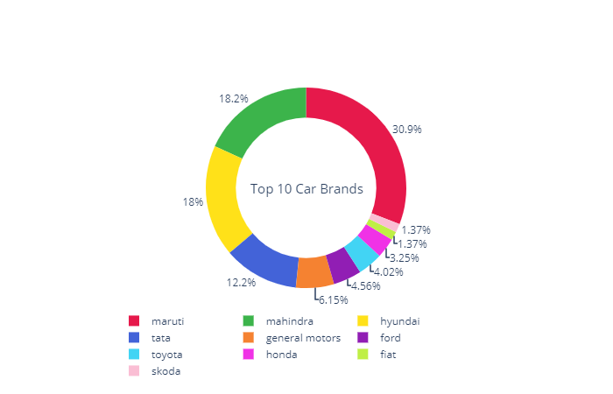
Overall Distribution of Car brands
Maruti has the highest Market Share,
followed by Mahindra and hyundai.
MFC has successfully provided its service to other brands also.

Slide 11
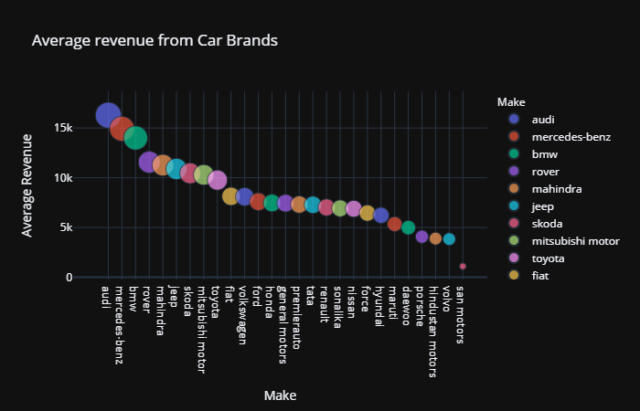
Average Revenue Analysis(Make Wise)
Average Revenue of Mahindra is almost double as compared to Maruti.
Maruti’s servicing parts are cheaper as compared to other brands.

Slide 12
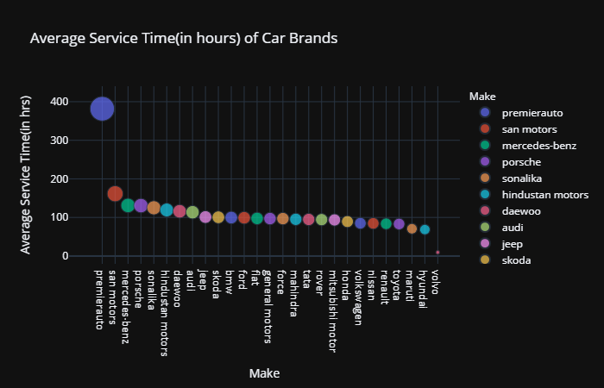
Average Service Time Analysis(Make Wise)
Average service time of most of the car brands fall under same range.

Slide 13
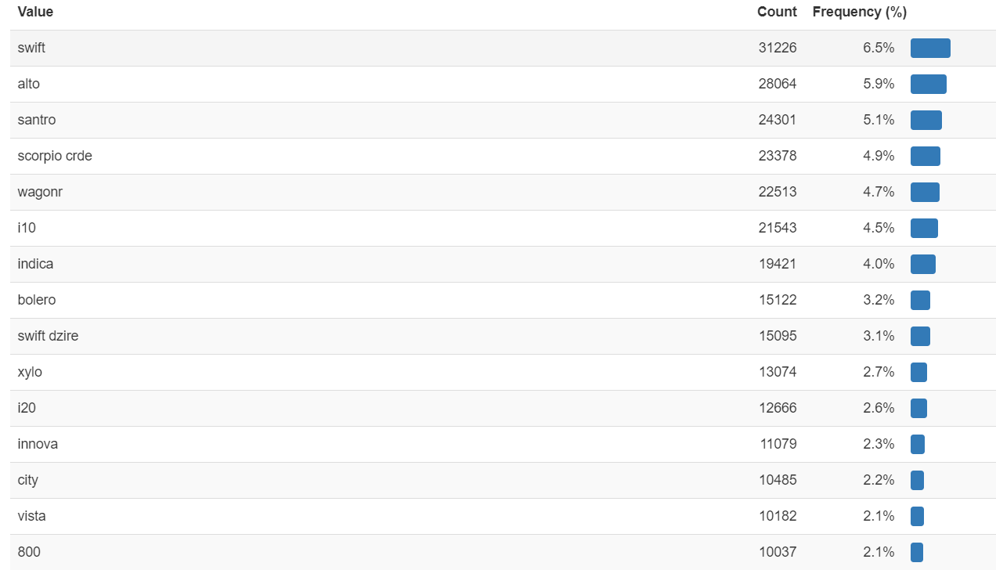
Model Wise Distribution
Most of the cars coming for servicing are Hatch-back models.
Servicing Cost for Hatch-back models is less.

Slide 14
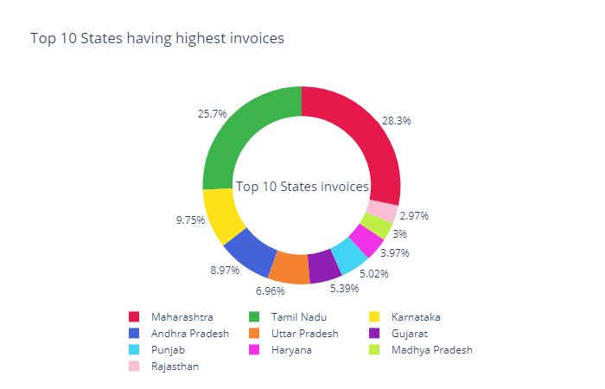
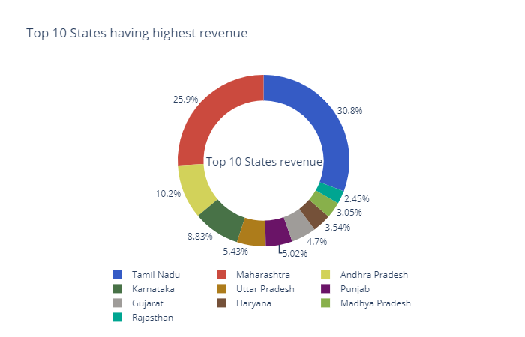
Revenue And Invoices Across States
To View DashBoard

Slide 15
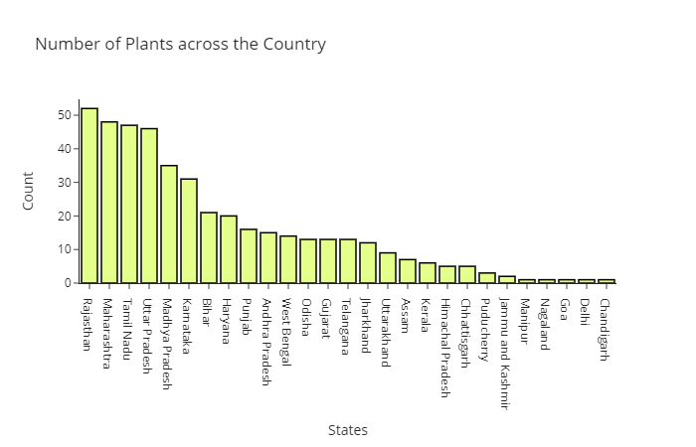
Plant wise Analysis
Rajasthan has the highest Plant count.
In Spite of highest plant count ,Rajasthan contributes less in Revenue Generation.
Despite of less number of plants in Maharashtra & Tamil Nadu , revenue generation is more.
To View Dashboard

Slide 16
Order Type Visualisation
.

Slide 17
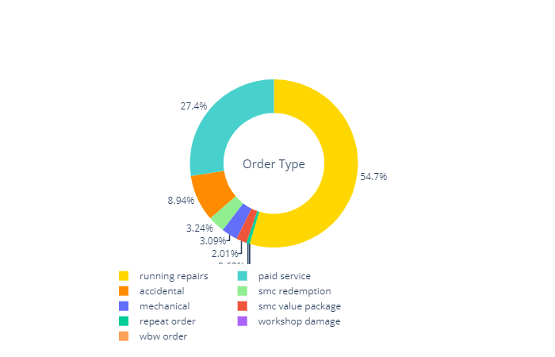
Overall Distribution Of Order Type
To View Dashboard

Slide 18
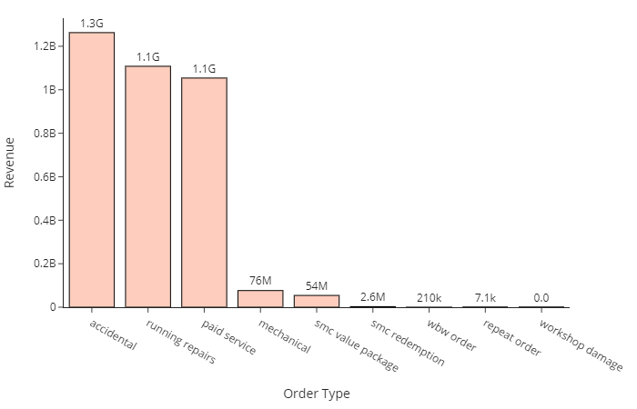
Overall Revenue Generation From Various Order Type

Slide 19
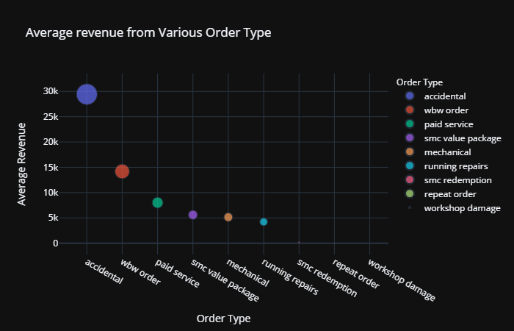
Average Revenue Analysis(Order Type)
.

Slide 20
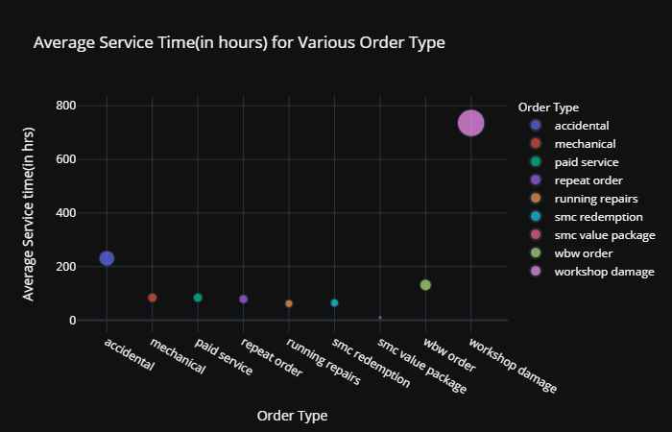
Average Service Time Analysis (Order Type)
.

Slide 21
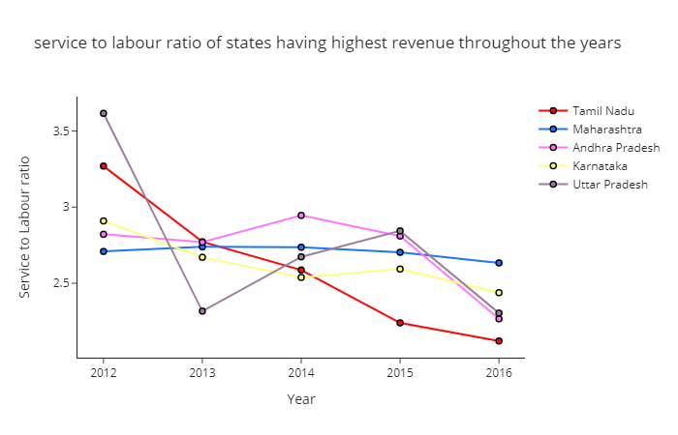
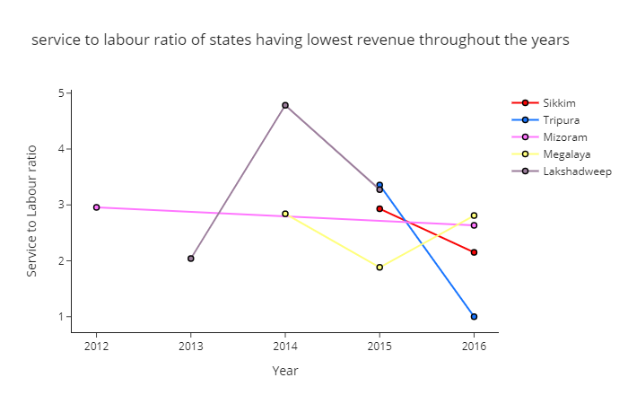
Service To Labour Value Ratio(State Wise)
The state having highest revenue shows continuous decline in service to labour ratio over the years
The state having lowest revenue shows random pattern in service to labor ratio over the years

Slide 22
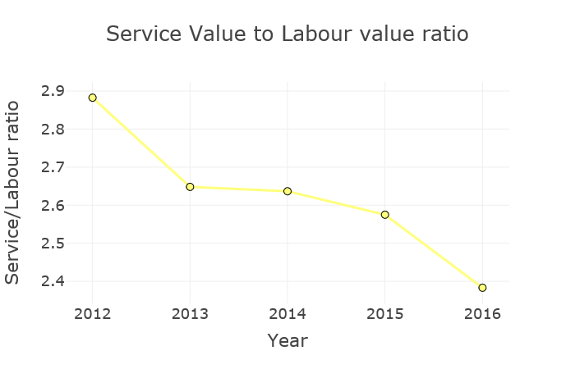
Overall Service To Labour Value Ratio(Year Wise)

Slide 23
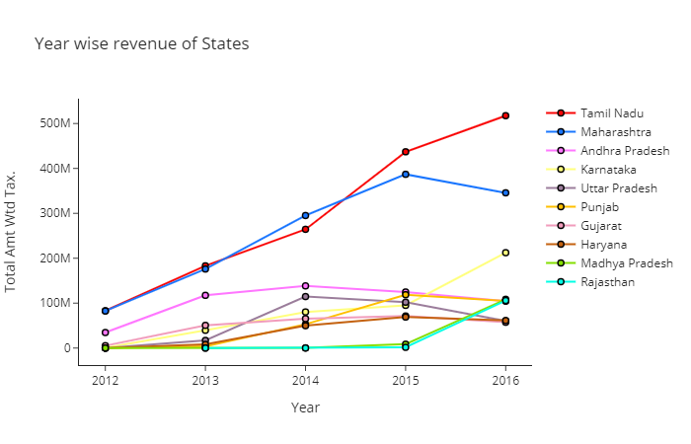
State Revenues over the years
.

Slide 24
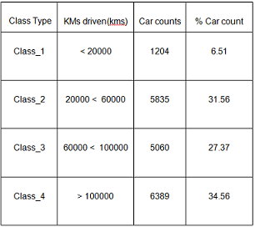
Classes based on kilometers of cars

Slide 25
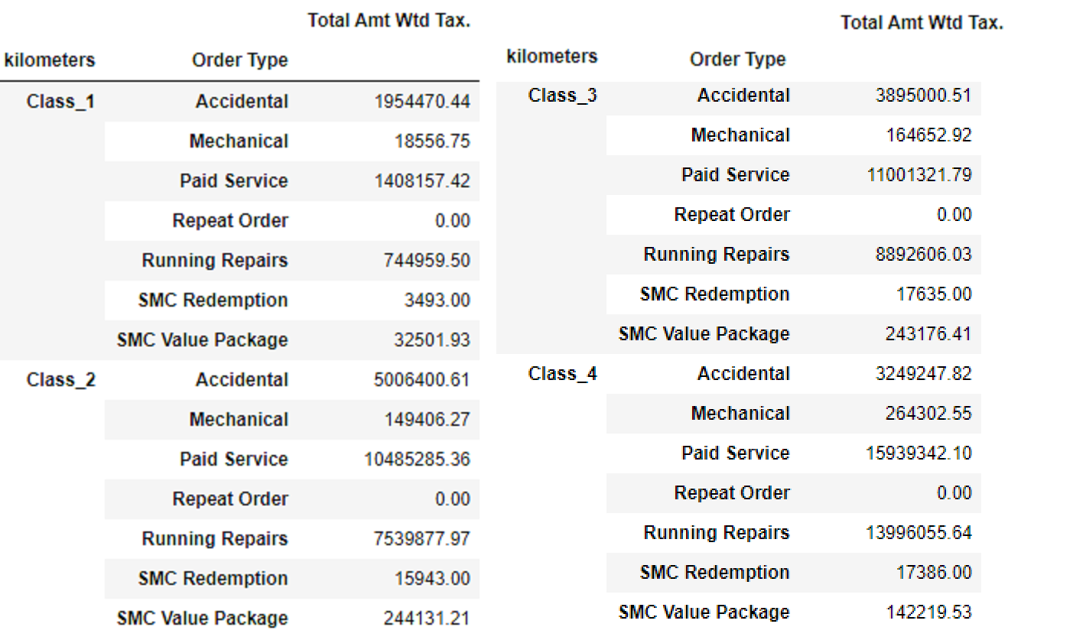

Slide 26
Market Segmentation-Cluster Analysis

Slide 27
Market Segmentation-MFC
Process of dividing a market of potential customers into groups, or segments, based on different characteristics
The segments created are composed of consumers who will respond similarly to marketing strategies and who share traits such as similar interests, needs, or locations
By arranging their company’s target market into segmented groups, rather than targeting each potential customer individually, marketers can be more efficient with their time, money, and other resources than if they were targeting consumers on an individual level.
Grouping similar consumers together allows marketers to target specific audiences in a cost effective manner

Slide 28
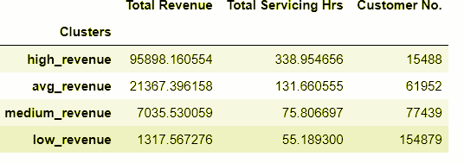
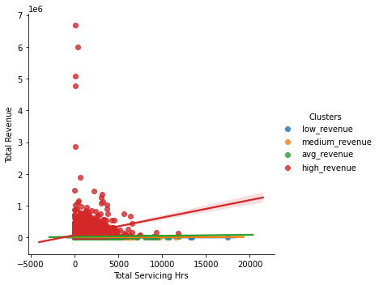
Rule Based Clustering based on avg revenue
Rule based clustering is performed based on quantile analysis of total revenue column

Slide 29
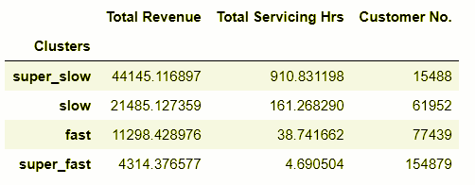
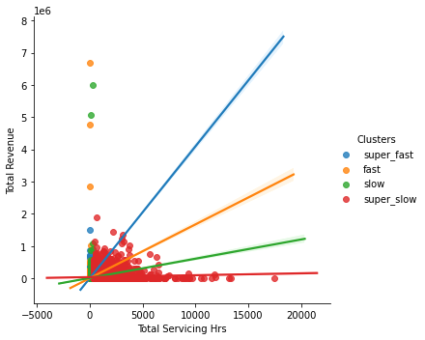
Rule Based Clustering based on avg servicing time

Slide 30
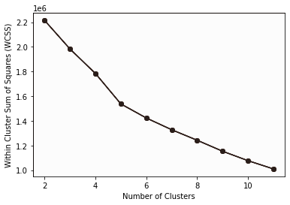
Calculating wcss score using elbow method

Slide 31
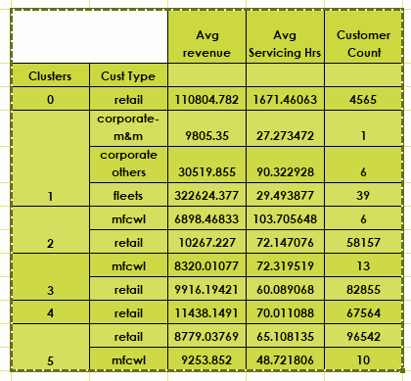
​K-Means Clustering

Slide 32
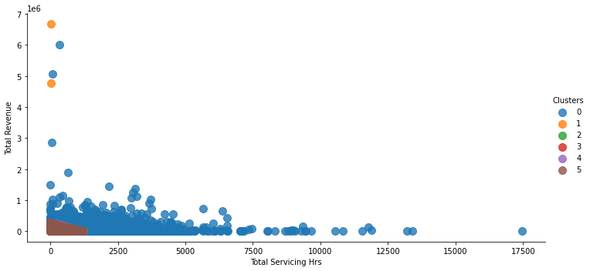
​K-Means Clustering

Slide 33
Customer Life Time Value Prediction(Classification & Regression)

Slide 34
Customer Life Time Value
Customer lifetime value is a metric that indicates the total revenue a business can reasonably expect from a single customer account.
It is calculated as Average purchase frequency multiplied by Average spend per visit.
Considered 2015 year data.
Business can use this metric to increase ROI.

Slide 35
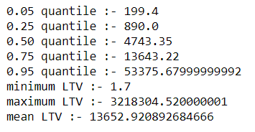
LTV Classification
Low Ltv Group (<=4743.35)
Medium Ltv Group( >4743.35 & <=13643.22)
High Ltv Group (>13643.22)
Customer Segments | CLV
Low Ltv | 53160080
Medium Ltv | 149136800
High Ltv | 775156700
Quantile Based Analysis

Slide 36
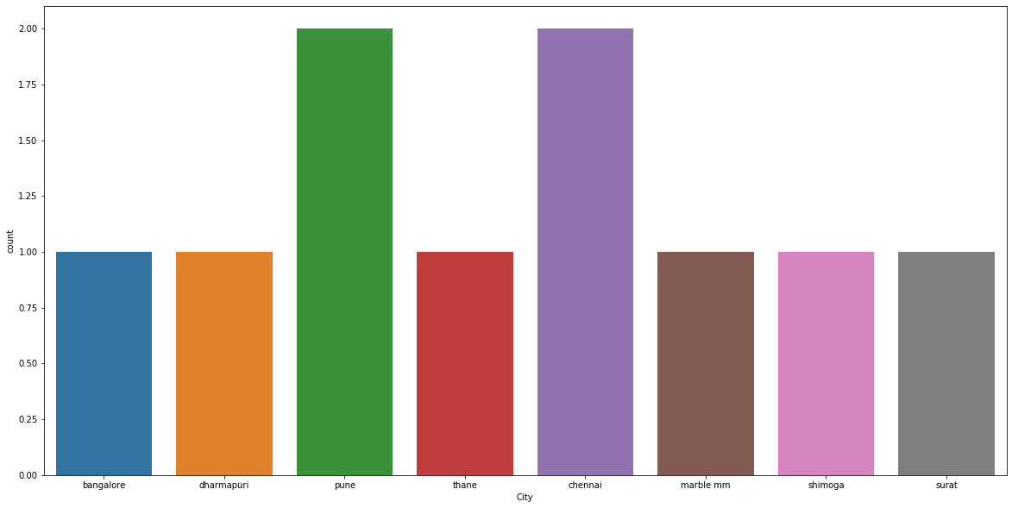
High LTV Analysis(City Wise)

Slide 37
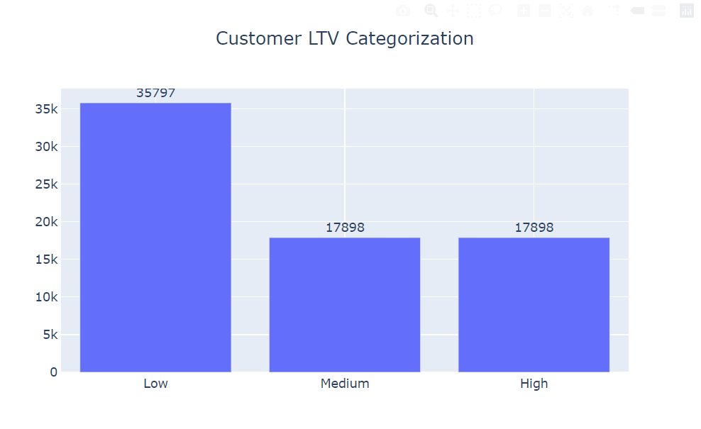
LTV Categories Analysis(Customer Counts)

Slide 38
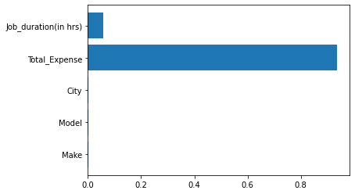
Feature Importance

Slide 39
Model Accuracy
Model | Score(Train Set) | Score(Test Set)
Decision Tree Classifier | 0.84 | 0.85
Random Forest Classifier | 0.85 | 0.85
XGB Classifier | 0.88 | 0.87

Slide 40
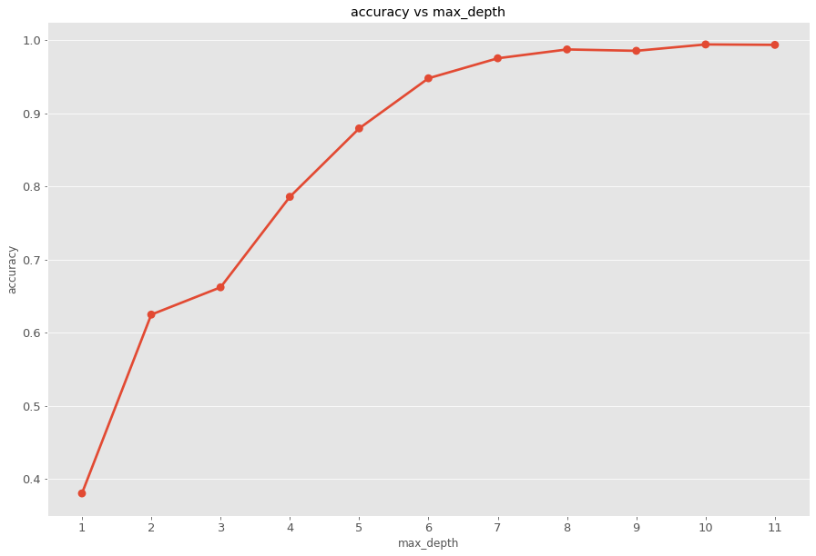
LTV Regression
LTV Regression output - Continuous value
We are going to build a simple machine learning model that predicts our customers lifetime value
Define an appropriate time frame for Customer Lifetime Value calculation
Identify the features we are going to use to predict LTV value of customers
Calculate lifetime value (LTV) for training the machine learning model
Build and run the machine learning model
Check if the model is useful

Slide 41
Model Running
Linear Regression
Xgb Regressor
Decision Tree Regressor
Random Forest Regressor
Value =.79
Value =.97
1 | 2 | 3 | 4 | 5 | 6 | 7 | 8 | 9 | 10
Value =.98
Value =.99

Slide 42
Suggestions
Increase the number of plants in Maharashtra and Tamil Nadu.
Organize training program for labours in states where average service time is more.
Spare parts of car brands which are manufactured in India must be stocked up inventory.
Since maximum number of cars visited are of Indian brands.
Promote our own insurance schemes which will help in reducing service time of accidental cases.
Promote digital transaction for hassle free operations.
Everytime taking feedback from the customers will help us to evaluate the quality of service done by MFC Plants.
Interact with the customers online through e-mails and send personalised service reminders and deals which are currently going on in our organisation.
Create a follow up program and referral rewards program

Slide 43

References
1.https://towardsdatascience.com/the-5-clustering-algorithms-data-scientists-need-to-know-a36d136ef68#:~:text=Clustering%20is%20a%20Machine%20Learning,the%20grouping%20of%20data%20points.&text=In%20theory%2C%20data%20points%20that,dissimilar%20properties%20and%2For%20features.
2.https://towardsdatascience.com/data-driven-growth-with-python-part-3-customer-lifetime-value-prediction-6017802f2e0f
3.https://stackoverflow.com/
4.https://plotly.com/
5.https://towardsdatascience.com/data-driven-growth-with-python-part-3-customer-lifetime-value-prediction-6017802f2e0f
2.

Slide 44

Thank you!

